Slide 1
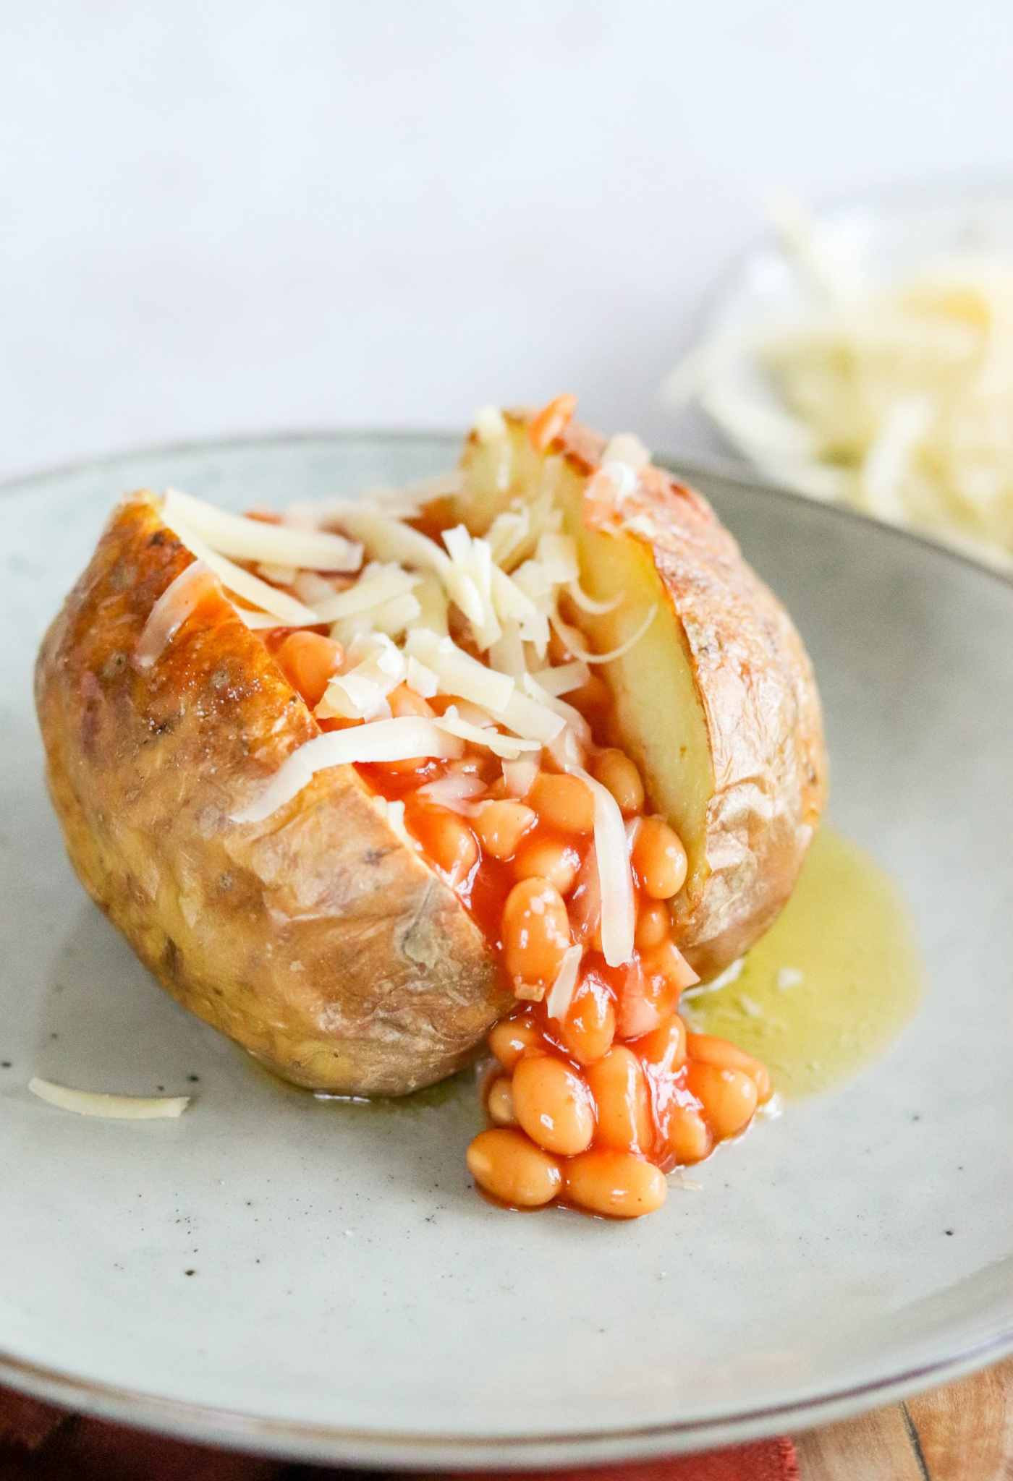


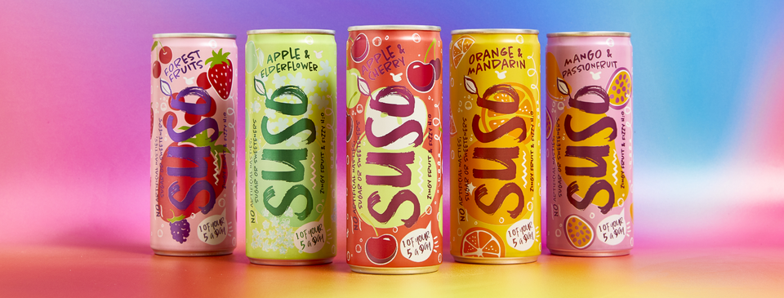

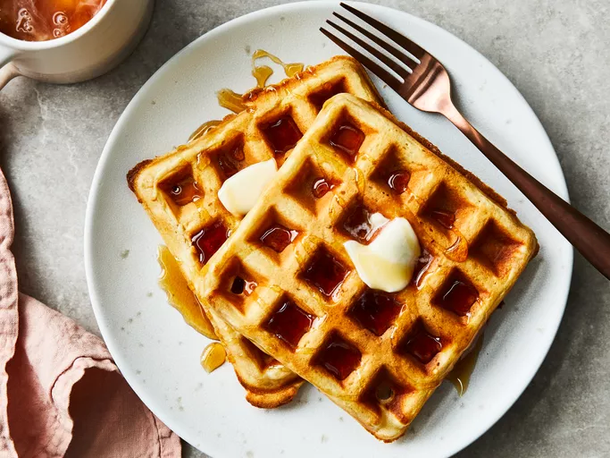
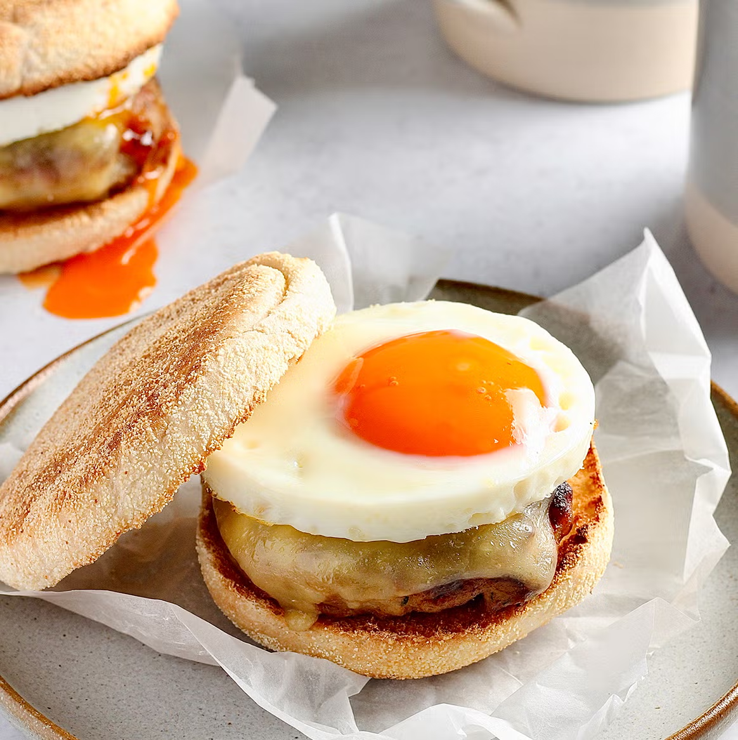
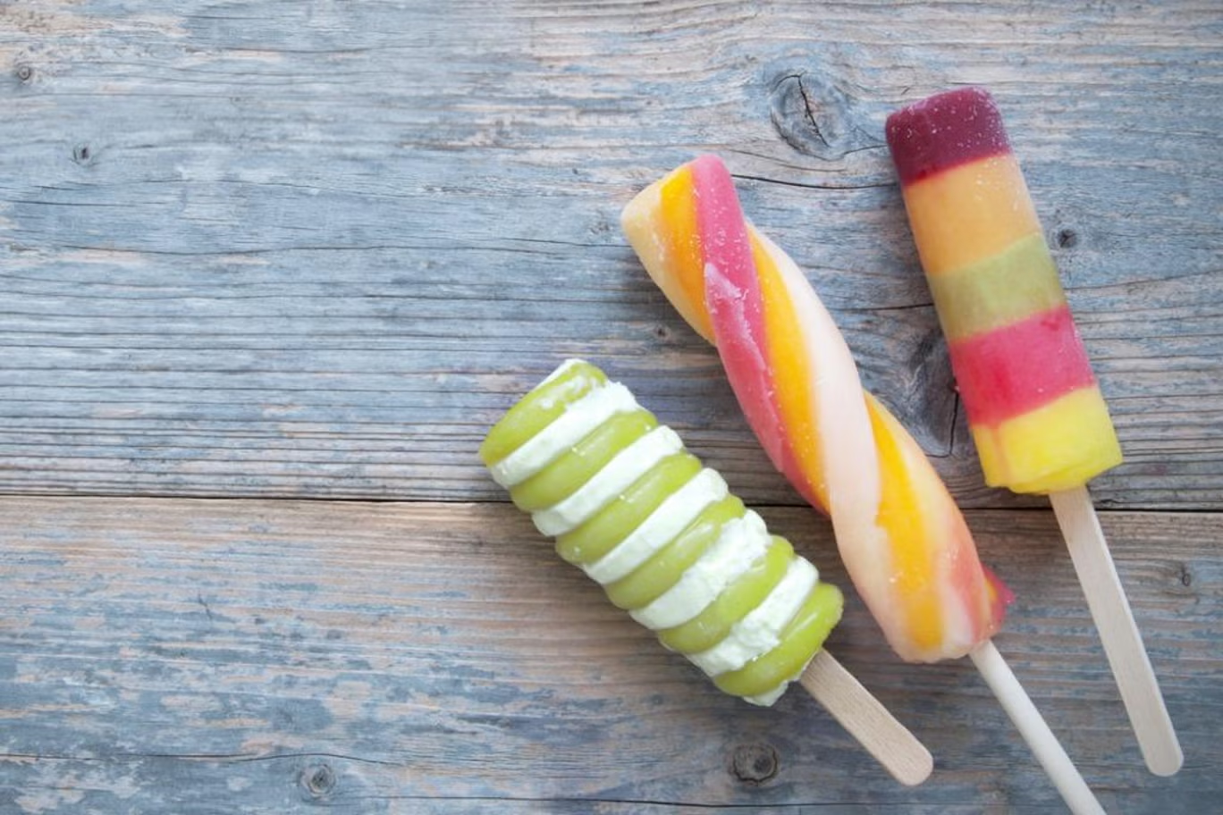
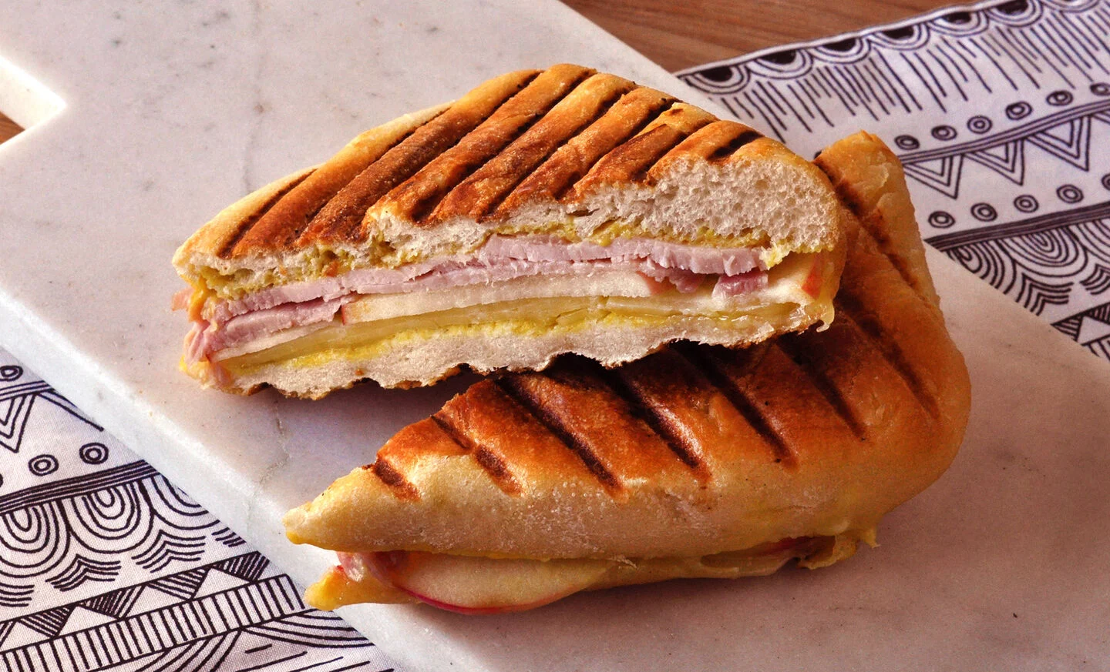
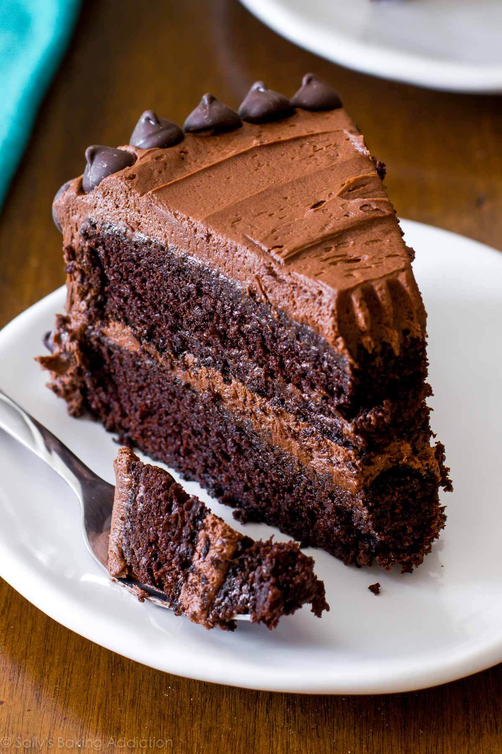
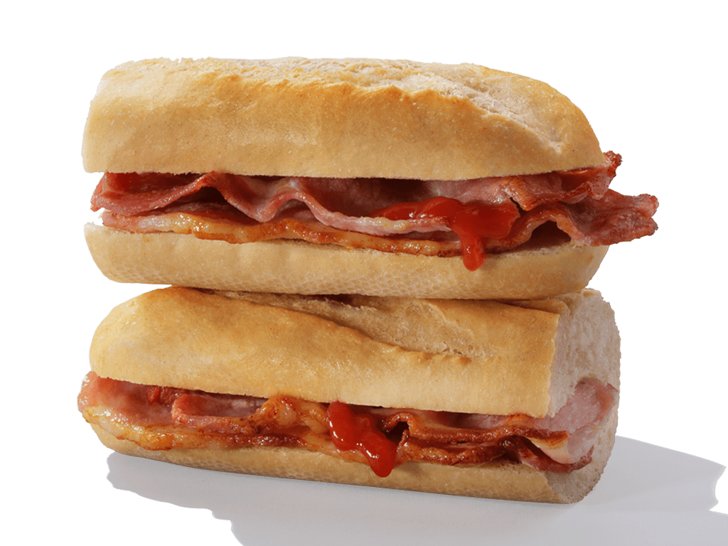
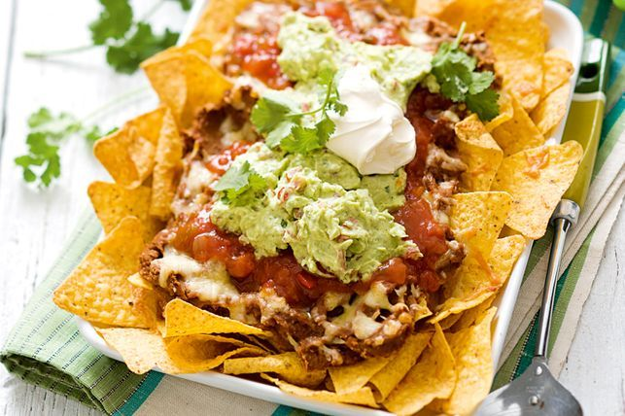
Secondary Price List 2026/2027

Slide 2

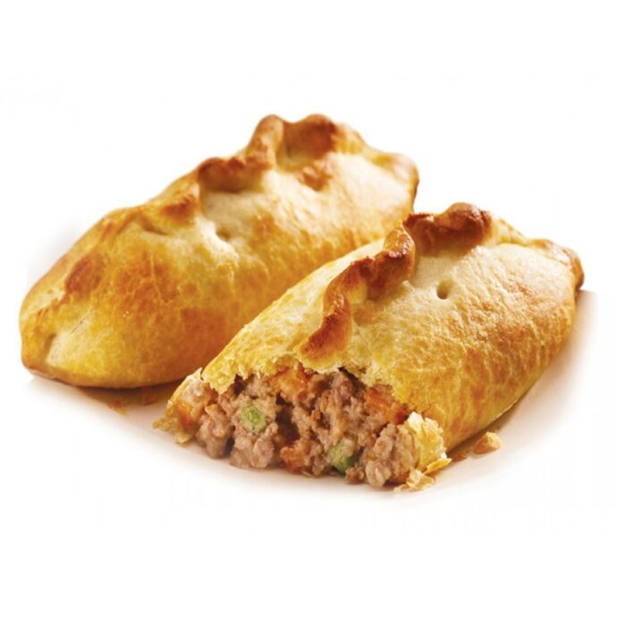
Breakfast / Break
Breakfast Baguette | £ 1.46
Whole Breakfast Baguette | £ 2.20
Breakfast Muffin | £ 2.00
Hash Brown | £ 0.85
Cereal | £ 1.14
Filled Croissant | £ 1.52
Sausage roll | £ 1.38
Pizza | £ 1.91
Waffles | £ 1.22
Toast/Crumpet | £ 0.79
Fruit | £ 0.79
Fruit Box | £ 1.63
Ketchup | £ 0.20
Savoury Pastry | £ 1.51
For adults and Teachers VAT will be Charged

Slide 3
Drinks
Water | £ 0.95
Radnor Fizz | £ 1.13
Radnor Splash | £ 1.65
Apple juice | £ 0.97
Orange juice | £ 0.97
Viva Milk Carton | £ 0.91
Yazoo Milkshake | £ 1.65
Capri Sun | £ 1.47
Ribena | £ 1.34
Suso Can | £ 1.36
For adults and Teachers VAT will be Charged.

Slide 4

SNACKS
Crisps | £ 1.22
Pringles | £ 1.54
Cake | £ 1.22
Nacho’s | £ 1.63
Ice Lolly | £ 1.22
Strawberry Split | £ 1.36
For adults and Teachers VAT will be Charged

Slide 5
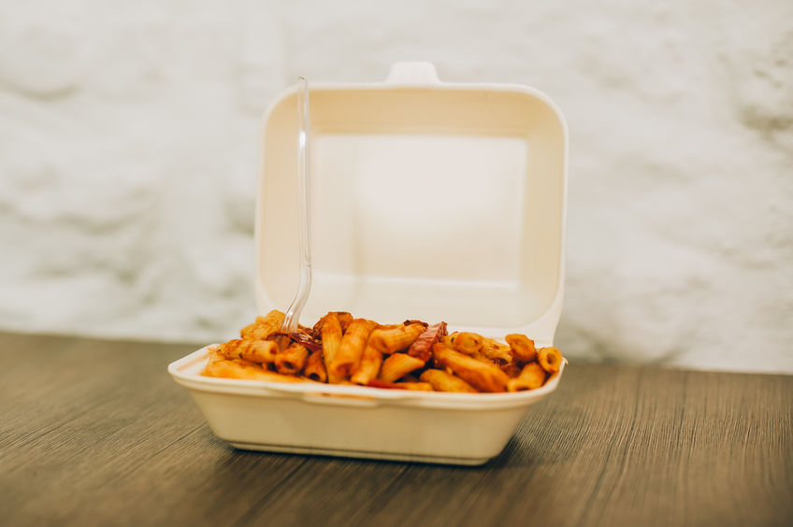
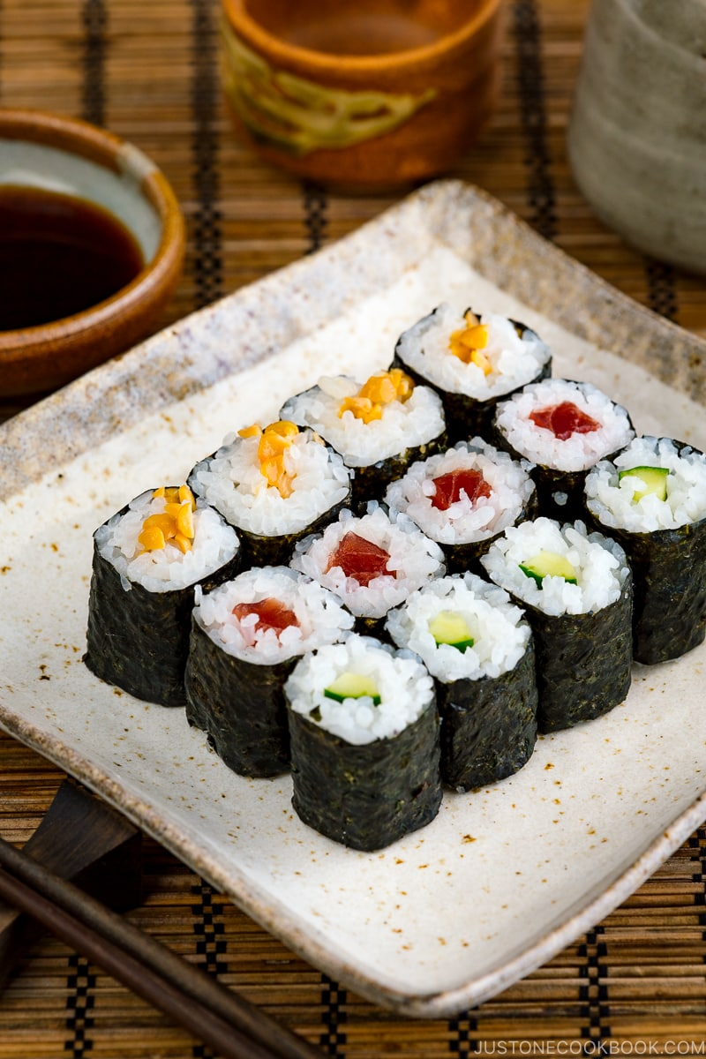
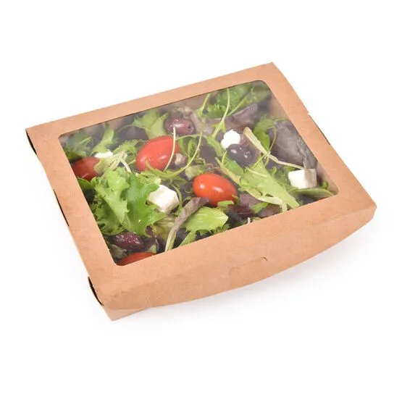
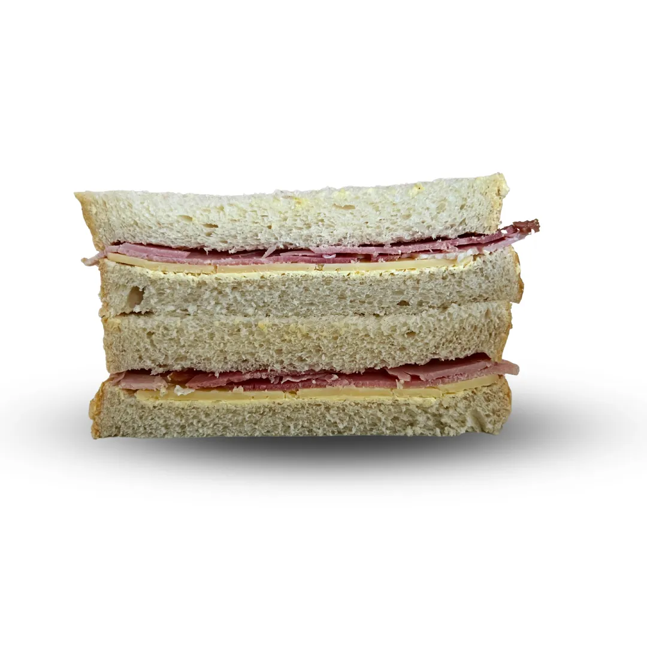
Lunch
Cold meal Deal | £ 3.50
Hot meal Deal | £ 3.50
Main Meal | £ 2.69
Jacket Potato x 1 Topping | £ 2.77
Pasta | £ 2.69
Panini | £ 2.91
Cold Pasta Pots | £ 1.56
Salad Box | £ 3.10
Basic Sandwich | £ 2.70
Premium Sandwich | £ 3.03
Extra Topping | £ 0.40
For adults and Teachers VAT will be Charged

Slide 6
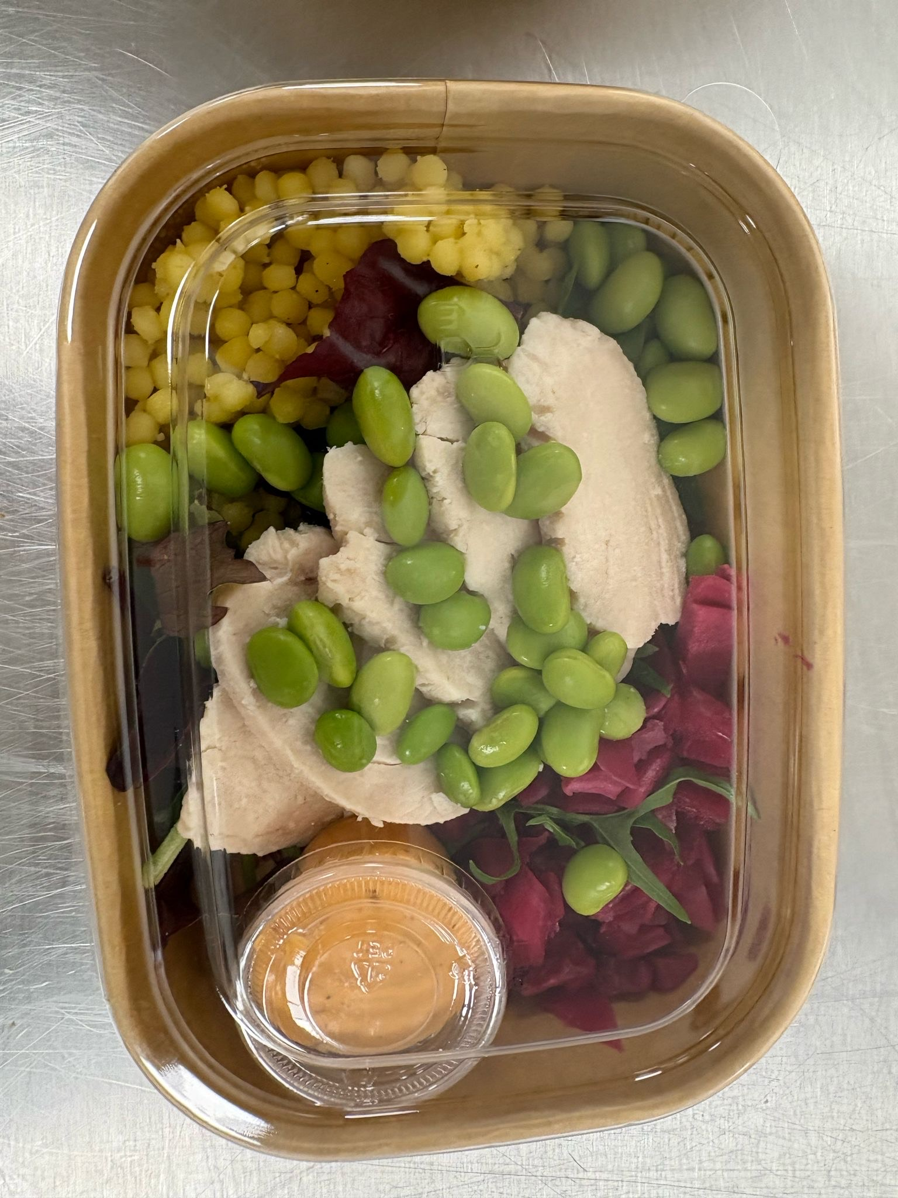
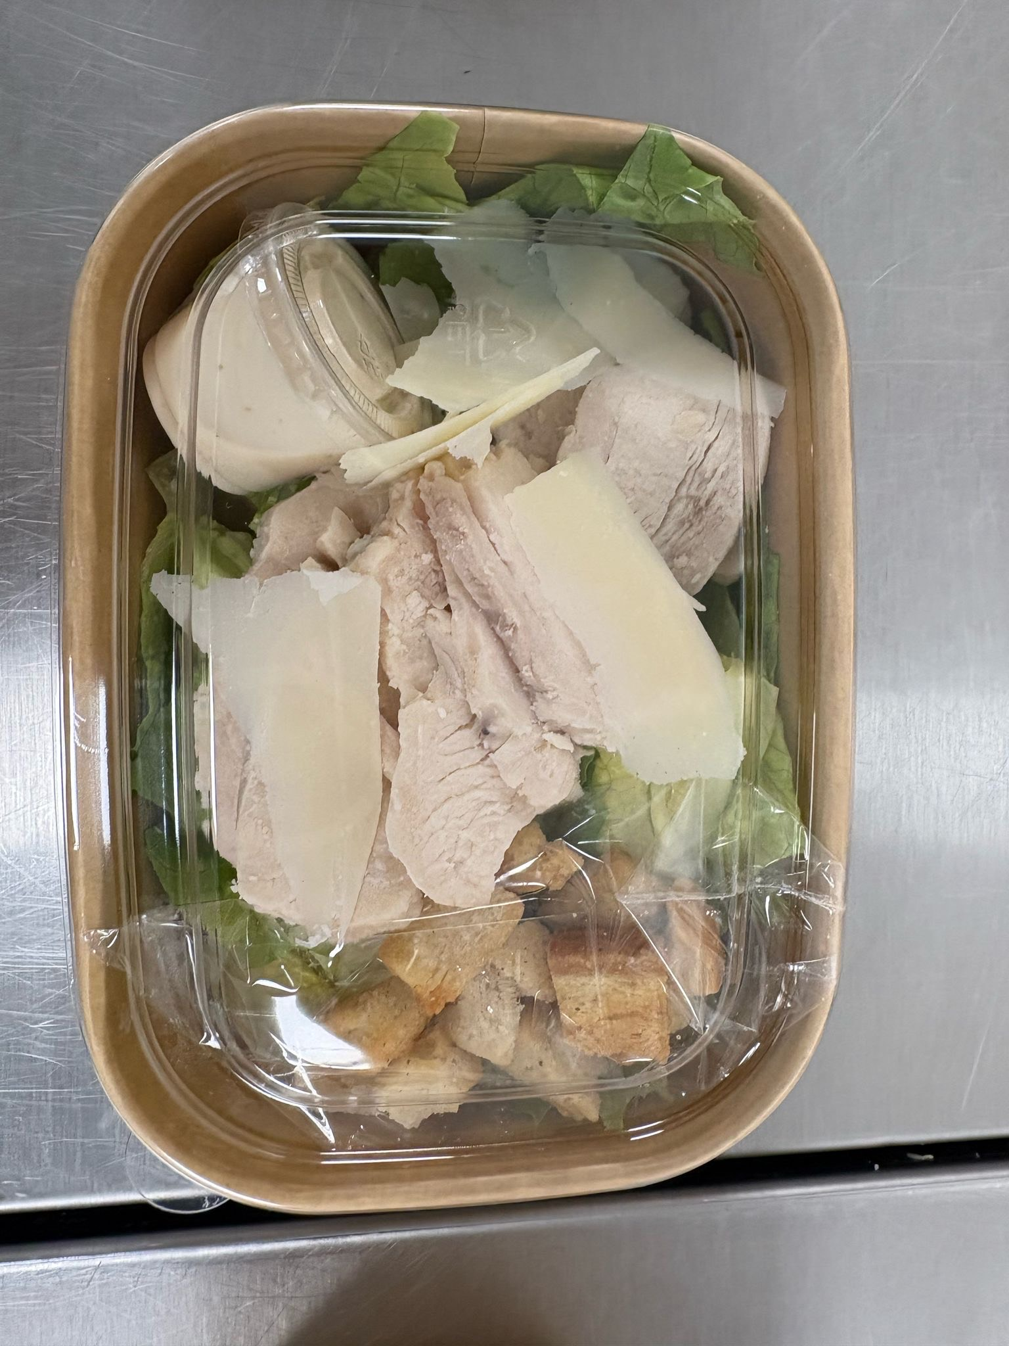
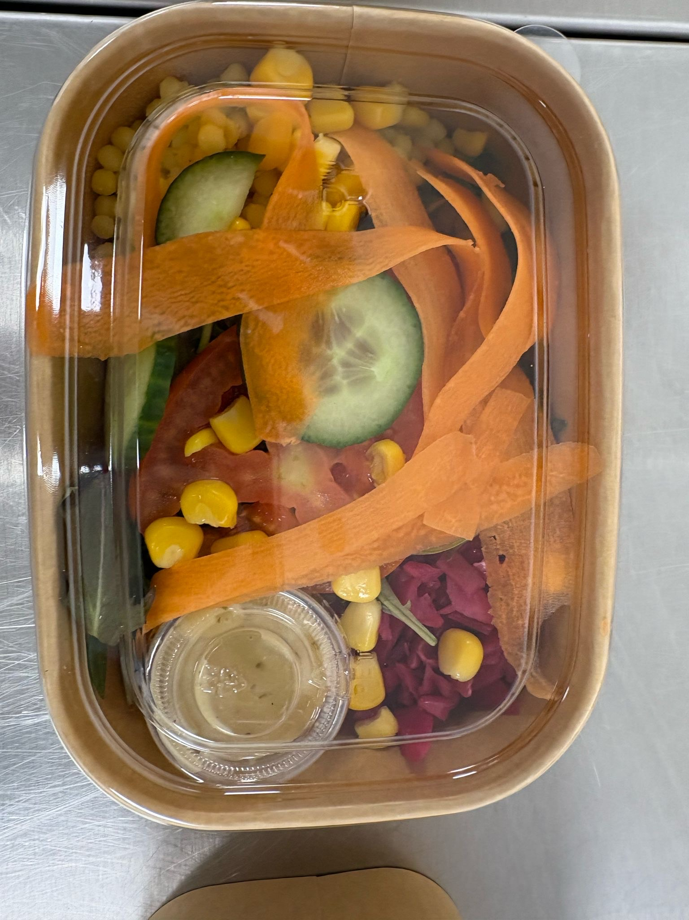
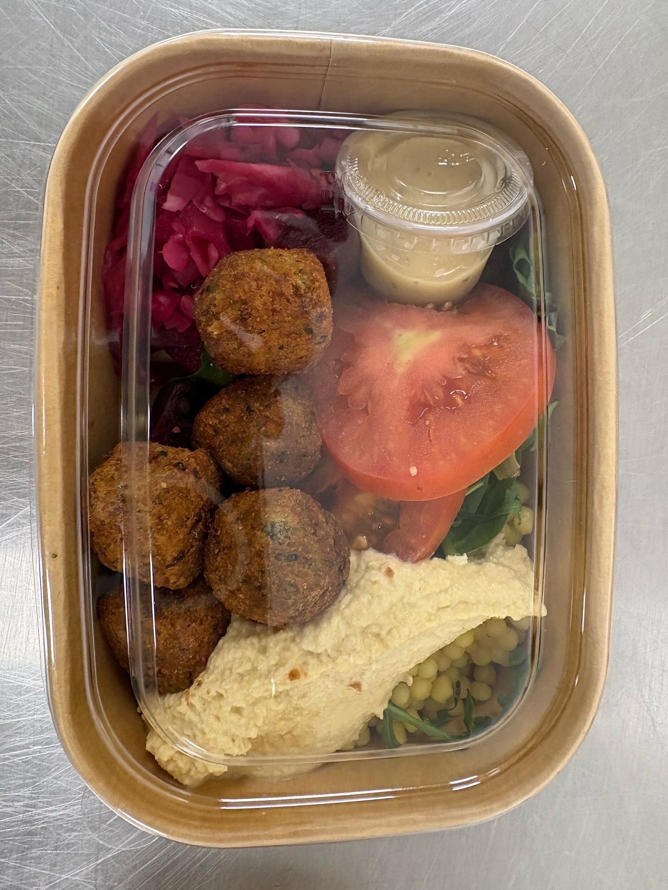
Salad Boxes
These are now available to purchase.

Slide 7
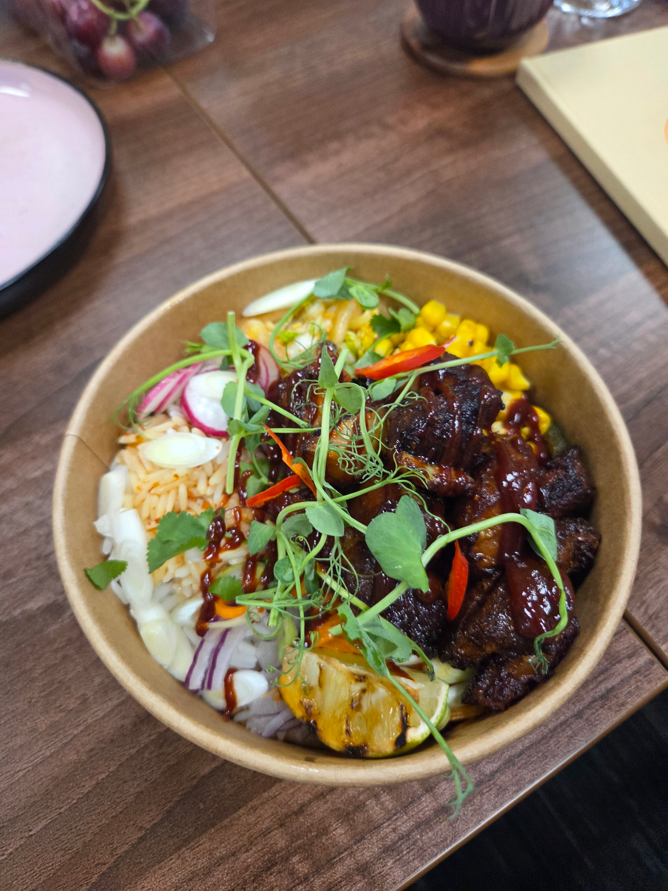
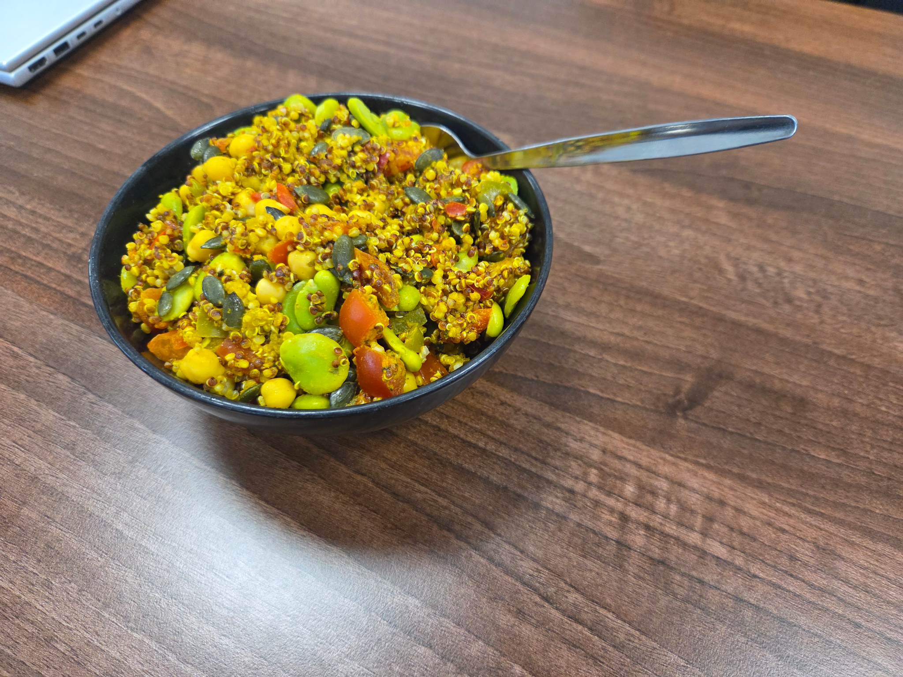
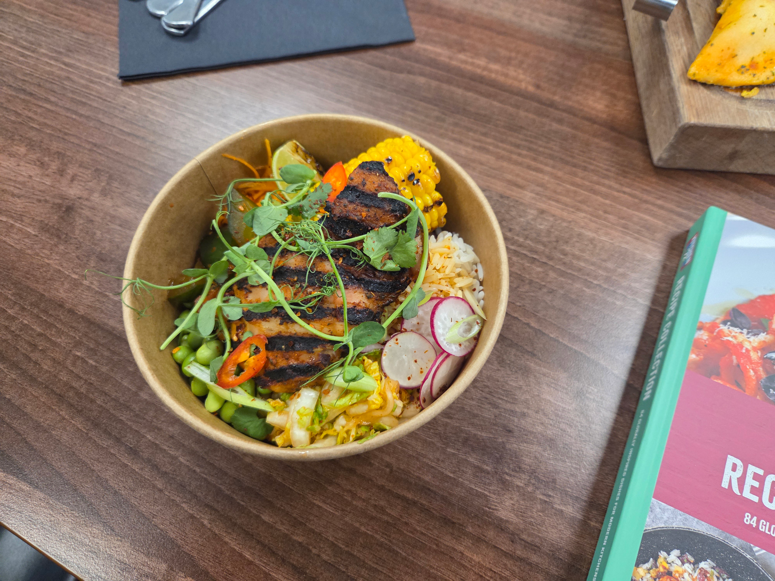
Sold at £3.10

